Slide 1
Secure Data LLC Security Control Plan

Slide 2
Security Program Implementation Plan
By
Jerrod Touchton
Chris Barnes
Sam Roethemeyer
Notes:
Legal, ethical and professional issues-Jerrod
incident response and business continuity-Sam
Physical security,building requirment,data center requirments,backup systems, access control, layer security-Chris

Slide 3
Legal Issues
HIPAA
The Health Insurance Portability and Accountability Act of 1996 (HIPAA), Public Law 104-191, was enacted on August 21, 1996. Sections 261 through 264 of HIPAA require the Secretary of HHS to publicize standards for the electronic exchange, privacy and security of health information. A major goal of the Privacy Rule is to assure that individuals’ health information is properly protected while allowing the flow of health information needed to provide and promote high quality health care and to protect the public's health and well being.Updates to HIPAA compliance went into effect on September 23, 2013. The Omnibus Rule now holds all third party contractors responsible for any data breach that may occur. This includes any subcontractors, entities or persons who transmit or receive protected health information (PHI). Previously, all liability was assumed by the hosting provider and not the business associates who directly or indirectly entered into a service agreement with the hosting provider.
Data center must provide adequate HIPAA data security measures to protect the data of their clients. Along with follow strict encryption and decryption guidelines.
SSL Certificates & HTTPS – All types of web-based access to a patient’s PHI are encrypted and secure to prevent unauthorized connections.
AES Encryption – Advanced Encryption Standard used to encrypt PHI stored on dedicated servers
A Virtual or Dedicated Private Firewall Services – A secure firewall will prevent any unauthorized access to protected files.
Remote VPN Access – Those with proper credentials will be able to access the protected network using a remote computer.
Disaster Recovery – A documented backup recover plan in case of lost PHI or server malfunction.
Dedicated IP Address – Private IP address that is cut off from the public Internet
Redundant, Isolated, and Secure database and web servers
High speed connection with hardware that can run a variety of software and application for communication with multiple types of devices.
Separate Test Server
Encryption and Decryption - 164.312(a)(2)(iv): Implement a method to encrypt and decrypt electronic protected health information.
Encryption - 164.312(e)(2)(ii): Implement a mechanism to encrypt electronic protected health information whenever deemed appropriate.

Slide 4
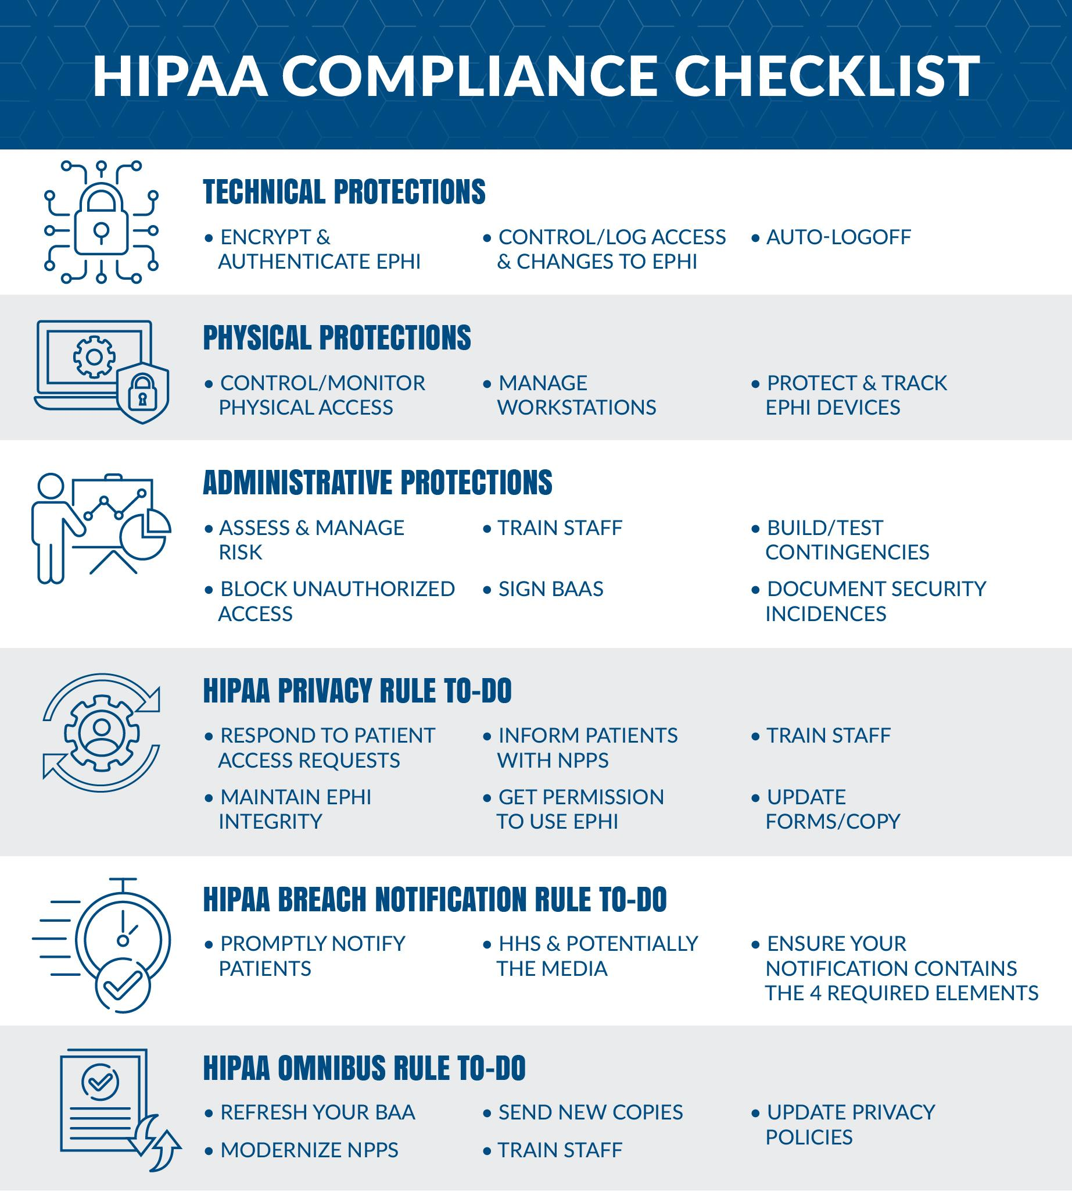
https://www.atlantic.net/hipaa-compliant-hosting/hipaa-compliance-guide-what-is-hipaa/

Slide 5
PCI DSS
The Payment Card Industry Security Standards Council (PCI SSC) was launched on September 7, 2006 to manage the ongoing evolution of the Payment Card Industry (PCI) security standards with a focus on improving payment account security throughout the transaction process. The PCI DSS is administered and managed by the PCI SSC (www.pcisecuritystandards.org), an independent body that was created by the major payment card brands. Note that PCI is not a law but just a standard that must be met to do business with any credit card company.
Data center must comply with the following physical security requirements.
There should be video surveillance to monitor entry and exit from data centers.
Access to data centers and physical copies of cardholder data should be restricted.
Where possible, access will be made using electronic badge systems. When not possible, access is logged manually via a Visitor Access Log as defined in your procedures.
Develop procedures to distinguish between on-site staff and visitors easily.
Record the visitor’s name, company represented, and on-site personnel allowing physical access in the logbook.
Unless otherwise restricted by law, access logs must be retained for at least three months.
When physical copies of cardholder data are moved between physical locations, the delivery method must be followed as defined in your transport procedures.
Physical access to data centers should be limited to authorized personnel, designated approved employees, or contractors whose job functions or responsibilities require such physical access.
Appropriate personnel IDs should be provided for access to data centers.
Procedures for removing access should be followed for employees who are no longer employed by the organization or transferred from a data center access role.
Visitors accessing data centers should be accompanied by authorized personnel, and all access should be recorded via the Visitor Access Log as defined in your procedures.
Visitors who need access to the network should only be allowed to access authorized systems by authorized personnel, and their access should be monitored.
Unless authorized in advance, the data center should have no network entrances to visitors, and access should only be allowed during the visit.
Failure to compy with PCI DSS standards will result in a 5,000 dollar fine and no longer the ability to process credit cards.
Environmental issues
Data centers providers are subject to various environmental and health and safety laws and regulations, including those relating to the generation, storage, handling and disposal of hazardous substances and technological equipment, the maintenance of facilities, the generation and use of electricity or other power, noise pollution and liability for historically contaminated land. In addition, data centers, as consumers of substantial amounts of electricity, are affected by a number of regulations which are capable of imposing liability for the cost of the investigation and remediation of contaminated sites on a strict causal basis, without regard to fault or the care taken in the disposal activity.
Notes:
What is PCI DSS
Not law but is a standard
Regulation because energy usage

Slide 6
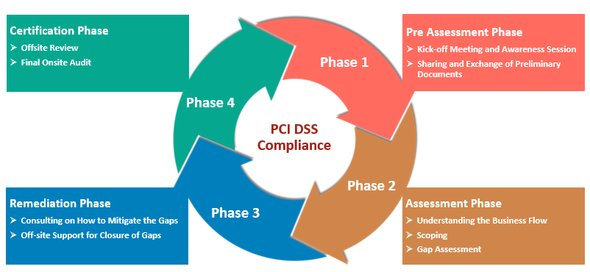
https://www.sisainfosec.com/services/pci-dss-compliance/

Slide 7
Ethical Issues
Noise pollution
Data center are loud and can be between 70-95 dBA this is not such a big issue if the center is away from any residential areas but in some cases they are and so more money needs to be invested to reduce the local noise pollution as to not break any local noise ordinance.
Power consumption
On a global scale, data center power consumption amounted to about 416 terawatts, or roughly three percent of all electricity generated on the planet.
water consumption
The typical data center uses about 3-5 million gallons of water per day.
A lot of that water is potable - that is drinking - water coming straight from the utility. This has become a hug debate over the use of drinking water especially is hard hit areas like Arizona where there is currently a 20 year drought happening.

Slide 8
Professional Issues
Disable accounts when people leave
Accounts will be disabled within 15 days after employee leaves the company.
Accounts will be deleted after 60 days of when employees leave the company.
Take key cards when people leave.
Forward employee email to their replacement.
After 90 days remove ex employee disable ex employee email account.
Remove employee from access list to the building within 15 days after employee leaves.

Slide 9
Incident Response
Incident Response team will be subject matter experts in a variety of topics to create a well-rounded team when needed
Early and accurate identification of incidents is key to strong and effective incident management
Keep track of previous incidents to identify patterns for faster and smoother remediations
It's easier and cheaper to prevent incidents rather than fixing incidents

Slide 10
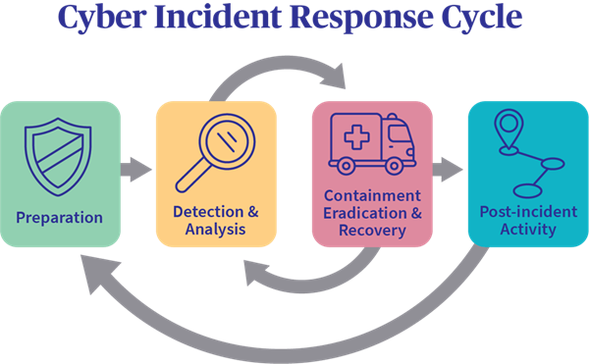
Incident Response Plan
Assess any incident reports and determine severity
If severity is high enough activate the Incident Response team with the right people based of the incident
Notify any affected businesses/customers that an incident has occured and remediation is underway
Begin remediation process
When finished, document everything that happened and keep it with other incident documentation to learn from later

Slide 11
Business Continuity and Disaster Recovery
Discuss with each client to create a BC/DR plan in the event of a disaster (natural or not) or any other event that disrupts the normal uptime of the client
In the event that the client has a disaster, make sure they have the necessary tools and IT infrastructure to be able to keep continuity and to start recovery
Keep redundancy throughout the data center in case a disaster happens at the data center (power, network, and environment)
Keep multiple lines of communication in the event that one or more ways to communicate is down

Slide 12
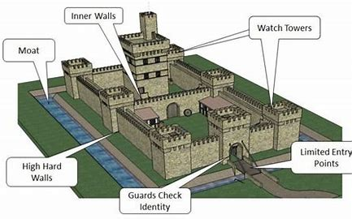
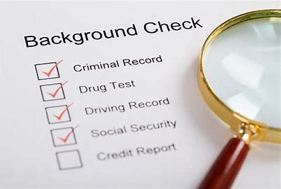
Physical Security
Zero Trust Policy
Pre-Employment Background check with annual checks
Monitoring systems for power, device added/resets
Guards at Entrance/Exits with Mantraps to access areas throughout building
Perimeter Fencing with 100 feet clear space proximity of building
Notes:
Physical security
Every person employed or contracted by the company will have the lowest access either to the building or data that is required in order to do their job
Each person will be required to do both a both a financial credit and criminal back round check
We will a have system that monitors power flucuations and a system that also monitors when a device is added or removed to the system
We will have mantraps that only allow on one person at a time with opening doors to allow for fire safety and allow for ADA act compliance
We will Hve permineter fencing with 100 foot clear space to allow for complete CCtv view of enterences and exits around the building

Slide 13
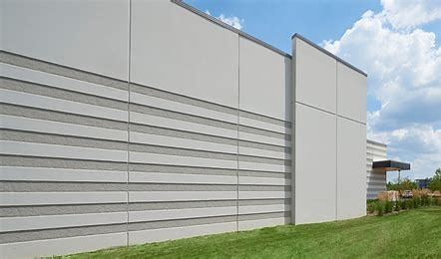
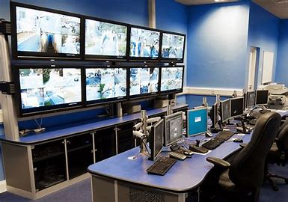
Building Requirements
Single Entry/Exit Point for Daily Use
Exit only Fire doors
Walls made of 1 foot thick reinforced Concrete
Closed-circuit Television
Humidity and Temperature Controls
No windows in Controlled areas
Visitors area with bathroom to keep unauthorized people out of secure areas
Notes:
Building

Slide 14
Data Center Requirements
50 Servers Cisco UCS C220 M6 Rack Server
25 Server Racks 42u UCoustic Soundproof Server Rack
Cat 6 Cable/ Fiber Optic cable
25 Switches 48-Port Gigabit Ethernet L2+ Fully Managed Switch
25 Cisco - 4351 Router
25 UPS UPS APC by Schneider Electric SRT10KRMXLI Smart-UPS

Slide 15
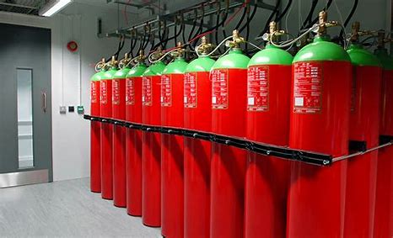
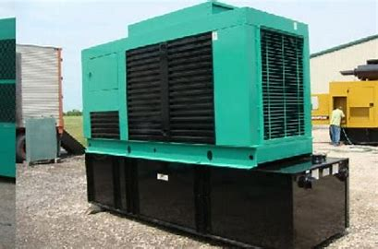
Backup systems
Uninterrupted power supply with generator backups
Provision of both a fire alarm system and an aspirating smoke detection system -Vesda system that detects and alerts before fire breaks out
Water leakage detector system
Halon Fire Suppression System in Server Areas

Slide 16
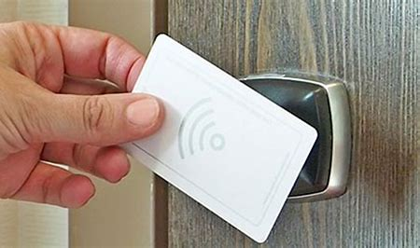
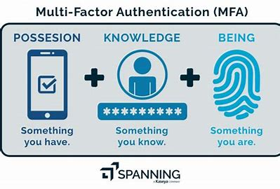
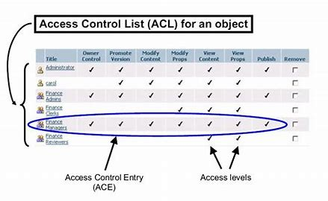
Access Control
Key cards
Only Authorized people in Controlled Spaces
Multi-Factor Authentication
Continuous monitoring and Monthly of access control rights

Slide 17
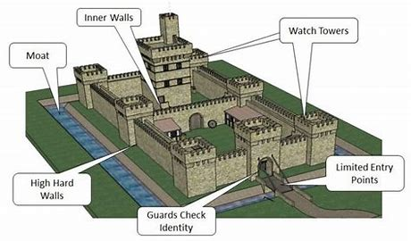
Layered Security
Anyone entering the most secure part of the data center will have been authenticated at least three times, including the following:
a. At the outer door. Security at the font with a secretary to receive guests
b. At the inner door. Separates visitor area from general employee area.
c. At the entrance to the "data" part of the data center. I person Enters/Exits at a time no piggybacking allowed.
A floor-to-ceiling turnstile. If someone tries to sneak in behind an authenticated user, the door gently revolves in the reverse direction. (In case of a fire, the walls of the turnstile flatten to allow quick egress.)
A "mantrap." Provides alternate access for equipment and for persons with disabilities. This is two separate doors with an airlock in between. Only one door can be opened at a time, and authentication is needed for both doors.
d. At the door to an individual computer processing room. This is for the room where servers, mainframes or other critical IT equipment is located. Provide access only on an as-needed basis, and segmented in order to control and track access.

Slide 18
References
(OCR), O. F. (2021, July 27). Summary of the HIPAA Privacy Rule. Retrieved from https://www.hhs.gov/hipaa/for-professionals/privacy/laws-regulations/index.html
Blake, S. (2021, November 16). Chandler neighbors annoyed by constant hum coming from giant datacenter. Retrieved from https://www.azfamily.com/news/features/chandler-neighbors-annoyed-by-constant-hum-coming-from-giant-datacenter/article_bef22562-466f-11ec-812e-ebb7dfd00c2e.html
Moss, S. (2021, October 21). Data center water usage remains hidden. Retrieved from https://www.datacenterdynamics.com/en/analysis/data-center-water-usage-remains-hidden/
PCI Compliance Guide Frequently Asked Questions: PCI DSS FAQs. (2017, September 05). Retrieved from https://www.pcicomplianceguide.org/faq/
Physical Security for Data Centers. (2019, October 23). Retrieved from https://protus3.com/physical-security-for-data-centers/

Slide 19
References (cont.)
Scalet, S. D. (2015, March 31). 19 ways to build physical security into your data center. Retrieved from https://www.csoonline.com/article/2112402/physical-security-19-ways-to-build-physical-security-into-a-data-center.html
Shailaja, C. (2020, March 31). Physical security of a data center. Retrieved from https://www.isa.org/intech-home/2020/march-april/departments/physical-security-of-a-data-center
07, M. V. (2015, July 07). In Data Center Incident Response, Automation is Key. Retrieved from https://www.datacenterknowledge.com/archives/2015/07/07/in-data-center-management-ounce-of-prevention-goes-a-long-way
Data incident response process | Documentation | Google Cloud. (n.d.). Retrieved from https://cloud.google.com/security/incident-response
Business Continuity & Disaster Recovery Planning (BCP & DRP): Imperva. (2019, December 30). Retrieved from https://www.imperva.com/learn/availability/business-continuity-planning/
Top Three Business Continuity Factors for Data Centers. (2017, October 05). Retrieved from https://avtech.com/articles/9245/top-three-business-continuity-factors-data-centers/

Slide 20
References 3
07, M. V. (2015, July 07). In Data Center Incident Response, Automation is Key. Retrieved from https://www.datacenterknowledge.com/archives/2015/07/07/in-data-center-management-ounce-of-prevention-goes-a-long-way
Data incident response process | Documentation | Google Cloud. (n.d.). Retrieved from https://cloud.google.com/security/incident-response
Business Continuity & Disaster Recovery Planning (BCP & DRP): Imperva. (2019, December 30). Retrieved from https://www.imperva.com/learn/availability/business-continuity-planning/
Top Three Business Continuity Factors for Data Centers. (2017, October 05). Retrieved from https://avtech.com/articles/9245/top-three-business-continuity-factors-data-centers/
PCI DSS compliance. (2021, May 26). SISA Information Security. https://www.sisainfosec.com/services/pci-dss-compliance/
What is HIPAA compliance? HIPAA compliance checklist & guide 2021. (2020, December 21). Atlantic.Net. https://www.atlantic.net/hipaa-compliant-hosting/hipaa-compliance-guide-what-is-hipaa/

