Slide 1
Boy Band
Hunter Ramirez, Colton Pritchard, Tyler Prettyman, Cristian Gonzalzes, Jerrod Touchton, and Sam Roethemeyer.

Slide 2
Deliverables
Setting up a network to support a 50-user office in Phoenix and a 10-user office in San Diego.
Designing a Diagram to showcase the network build.

Slide 3
Initialization
- Created 6 VMs using pod 21 named (BoyBand.local) - 1 PDC - 1 BDC - 2 DHCP - 2 DNS - Created an Architecture Diagram

Slide 4
Active Directory
Active Directory – Is a windows service that allows and enables administrators to manage permissions and access to network features and resources.

Slide 5
PDC Successful Setup

Slide 6
BDC Successful Setup

Slide 7
DNS
DNS (Domain Name System) – Uses a method to turn domain names for things like computers, services, and other resources into IP addresses.

Slide 8
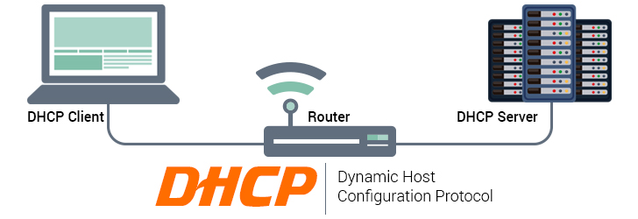
DHCP
DHCP (Dynamic Host Configuration Protocol) – Is a network management protocol that is used for automatically assigning IP addresses.

Slide 9
DHCP Configs

Slide 10
VOIP
VOIP (Voice Over Internet Protocol) – Is a method and group of technologies for the delivery of voice communications on an internet Protocol networks which includes the internet

Slide 11
Architecture
Packet tracer architecture of the network.

Slide 12
Group Policy
Group Policy - an infrastructure that allows you to specify managed configurations for users and computers through Group Policy settings and Group Policy Preferences.

Slide 13
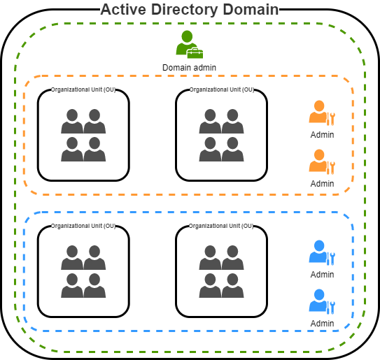
GPO Policies
Password Prompt
Password Age
Access to Control Panel
Account lockout
Disabled guest account
Machine idle time
Do not store lan manager
Password change prompt
Do not allow anonymous enumeration of SAM accounts

Slide 14
Users
More restrictions.
Hiding control panel so they don't have access to change computer base setting.
Not able to download programs to the computer.

Slide 15
Local Administrator
More tools available to them
Ability to use command prompt, control panel, and change computer settings.
Able to image machines to have all the software users need, as well as push out updates to your environment.

Slide 16
Resources
What is active directory? how does it work? Quest. (n.d.). Retrieved April 24, 2022, from https://www.quest.com/solutions/active-directory/what-is-active-directory.aspx What is DNS? | how DNS works | cloudflare. (n.d.). Retrieved April 24, 2022, from https://www.cloudflare.com/learning/dns/what-is-dns/
Mosley, D. (2022, April 3). DHCP design principles - designing infrastructure windows server 2003. Windows Server Brain. Retrieved April 24, 2022, from https://www.serverbrain.org/designing-infrastructure-2003/dhcp-design-principles.html

